Slide 1

ADABOOST
ALGORITHM

Slide 2

OUR TEAM
SHAIK MOHSIN HUSSAIN
ASHRITH REDDY
DEEPTHI REDDY
SANDEEP PALLERI
JAINA VINAY

Slide 3
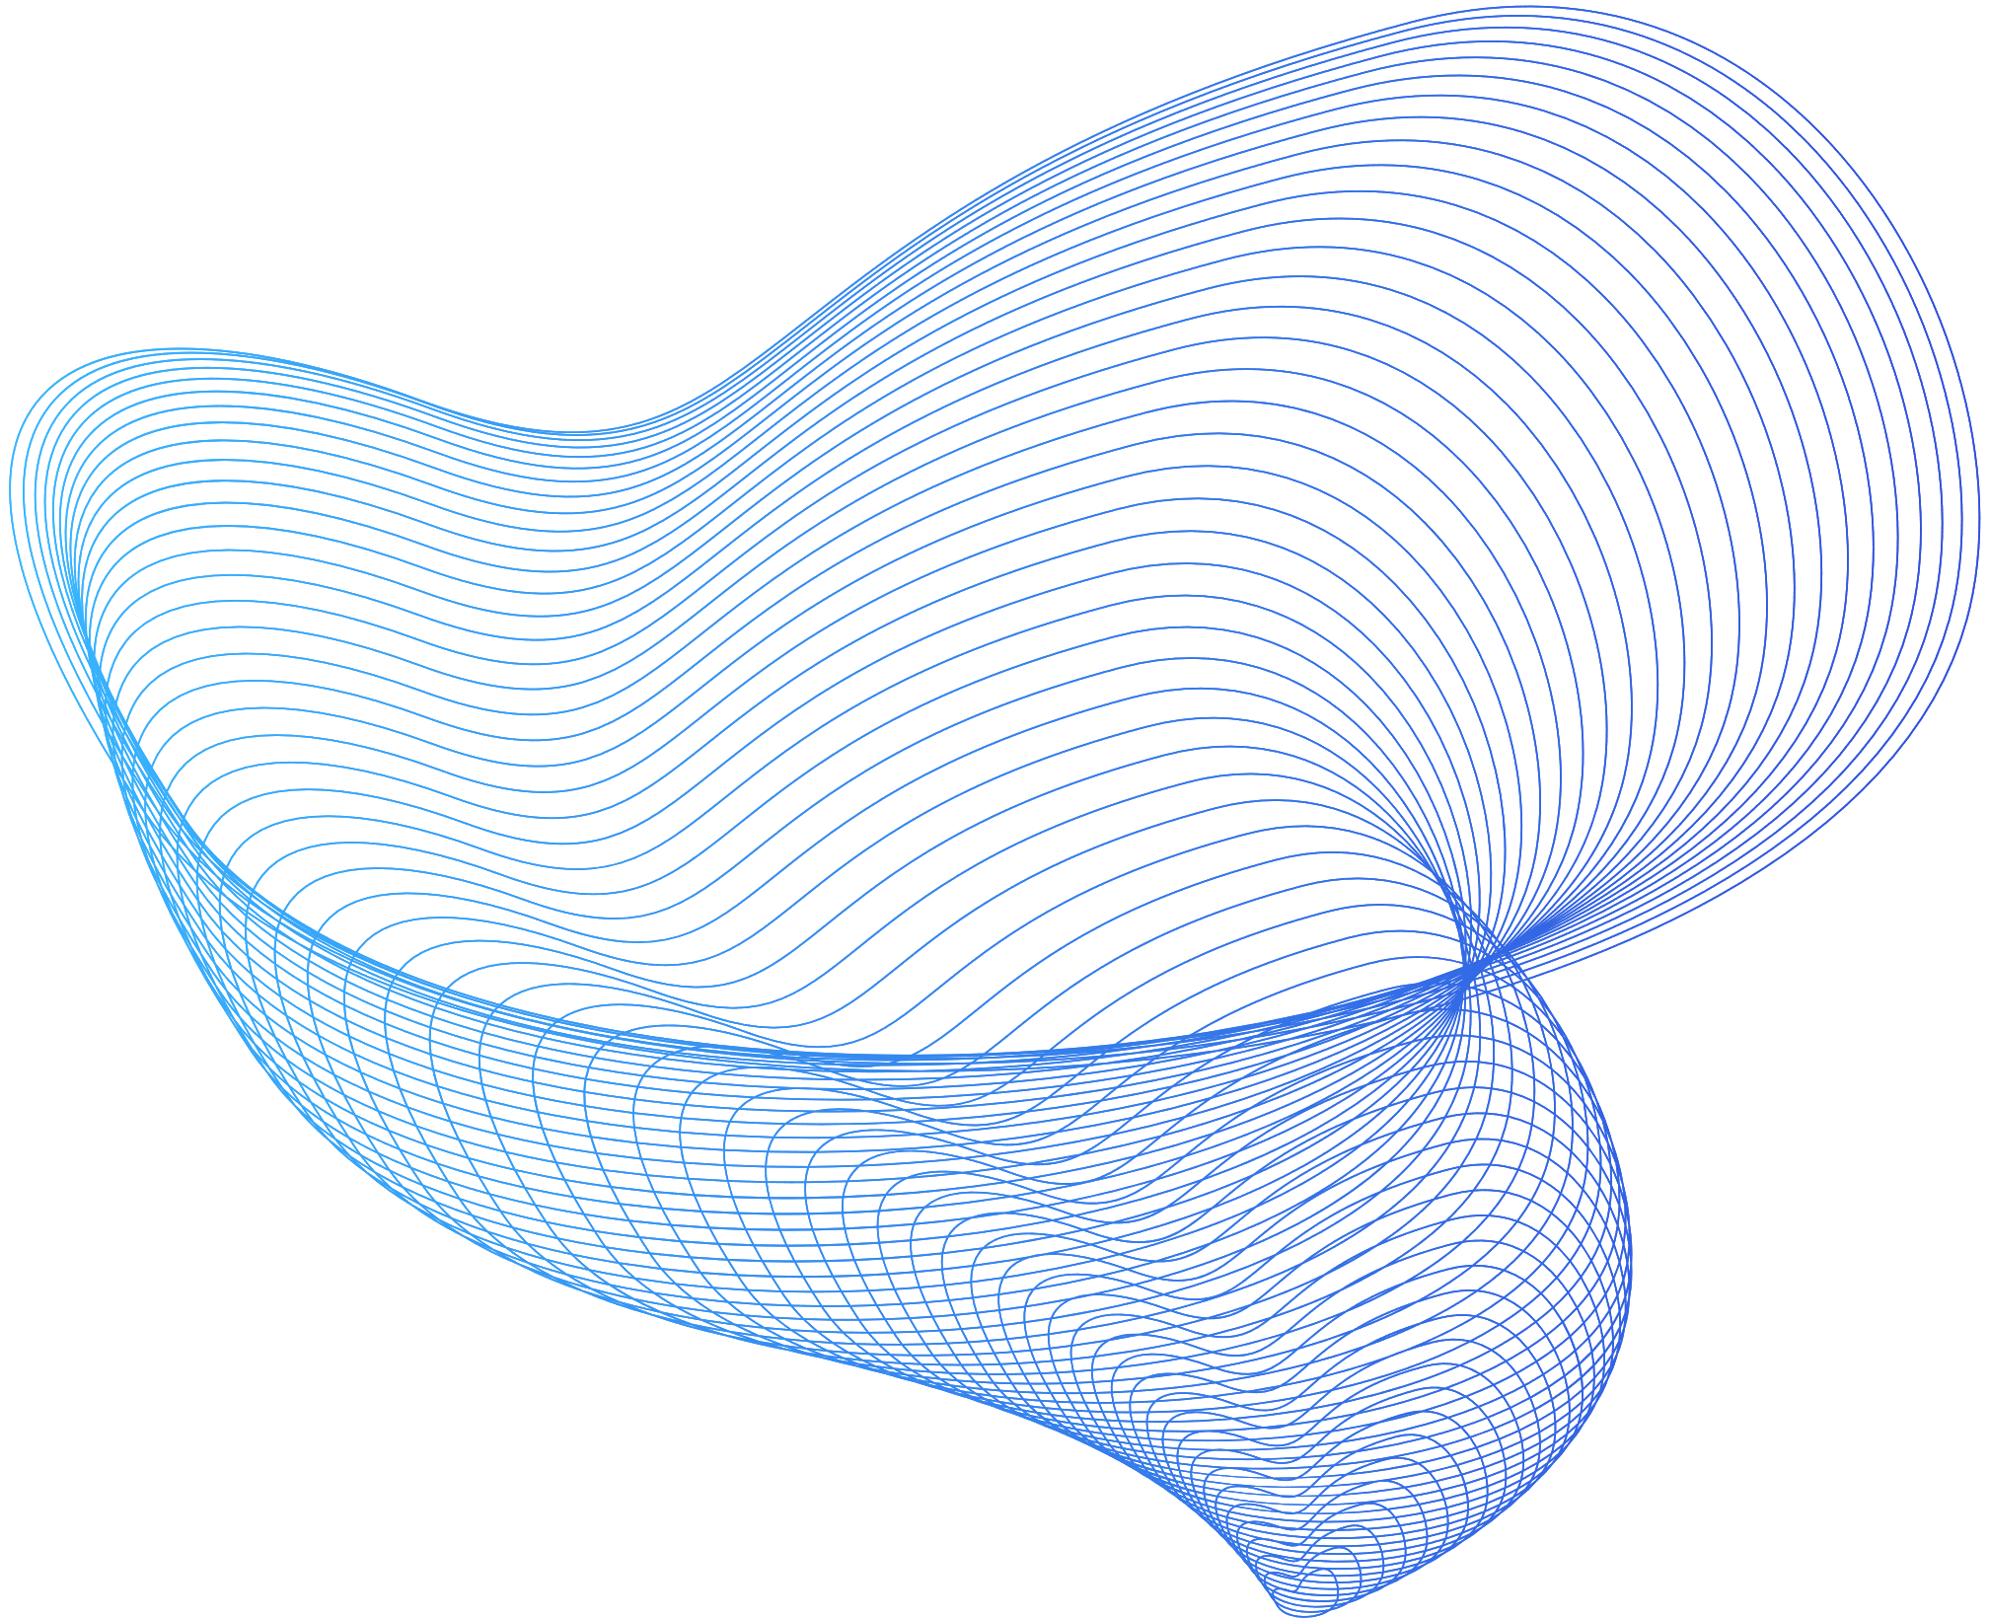

INTRODUCTION
Boosting is an ensemble modelling technique that was first presented by Freund and Schapire in the year 1997. Since then, Boosting has been a prevalent technique for tackling binary classification problems.
The principle behind boosting algorithms is that we first build a model on the training dataset and then build a second model to rectify the errors present in the first model. This procedure is continued until and unless the errors are minimized and the dataset is predicted correctly.
Thereby, Boosting algorithms improve the prediction power by combining multiple models
(weak learners) to reach the final output (strong learners).

Slide 4
BOOSTING TECHNIQUE
DATA SET

Slide 5

BOOSTING TECHNIQUE
DATA SET
B1

Slide 6

BOOSTING TECHNIQUE
DATA SET
B1
CORRECT
INCORRECTLY
CLASSIFIED

Slide 7
BOOSTING TECHNIQUE
DATA SET
B1
CORRECT
B2
WRONG
CORRECT

Slide 8
BOOSTING TECHNIQUE
DATA SET
B1
CORRECT
B2
WRONG
CORRECT
B3
WRONG
CORRECT
WRONG

Slide 9
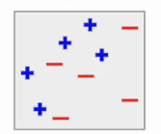
ADABOOST
The main idea behind AdaBoost is to combine multiple weak learners (often decision trees) to create a strong learner. The weak learners are trained sequentially, with each subsequent learner paying more attention to the instances that were misclassified by the previous learners. This adaptive nature of AdaBoost gives it the ability to focus on difficult-to-predict instances and improve the overall performance of the model.
Let’s understand how this is
This is my complete data. Here, I have the blue positives and red negatives.

Slide 10
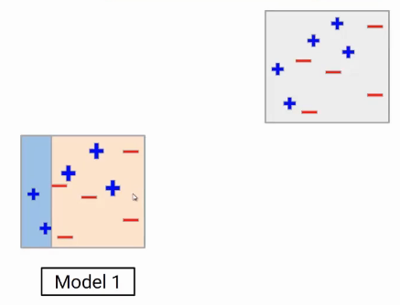
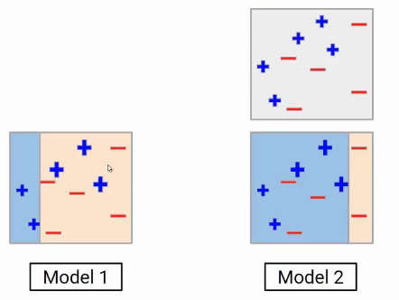
ADABOOST
Model-1
Suppose the first model gives the following result, where it is able to classify two blue points on the left side and all red points correctly.
Model-2
These miss- classified data points will be given higher weight. So these three blue positive points will be given higher weights in the next iteration.

Slide 11
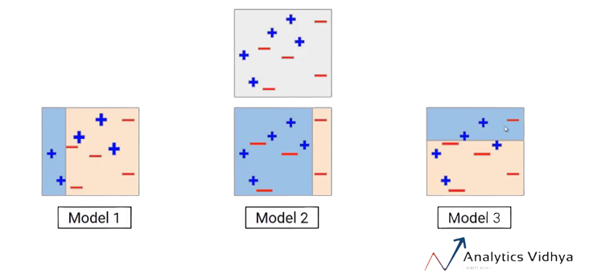
ADABOOST
Model-3
These miss-classified red points will get a higher weight. Again we will build another model and do the predictions.

Slide 12
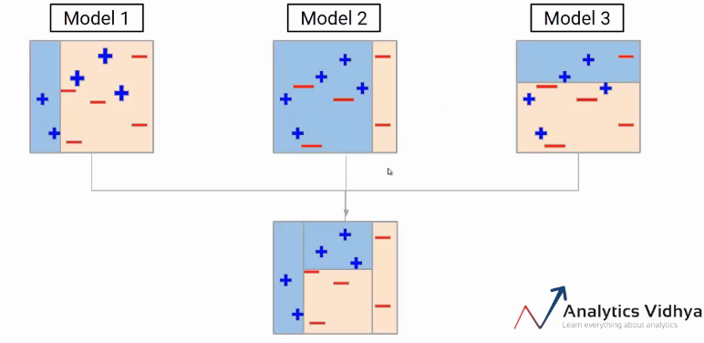
ADABOOST
ENSEMBLE
we have to aggregate these models. One of the ways could be taking the weighted average of the individual weak learners. So our final model will be the weighted mean of individual models.

Slide 13
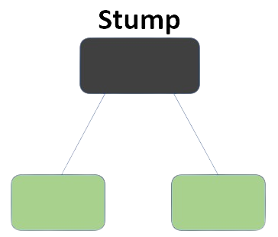
ADABOOST
AdaBoost, also called Adaptive Boosting, is a technique in Machine Learning used as an Ensemble Method. The most common estimator used with AdaBoost is decision trees with one level which means Decision trees with only 1 split. These trees are also called Decision Stumps.

Slide 14
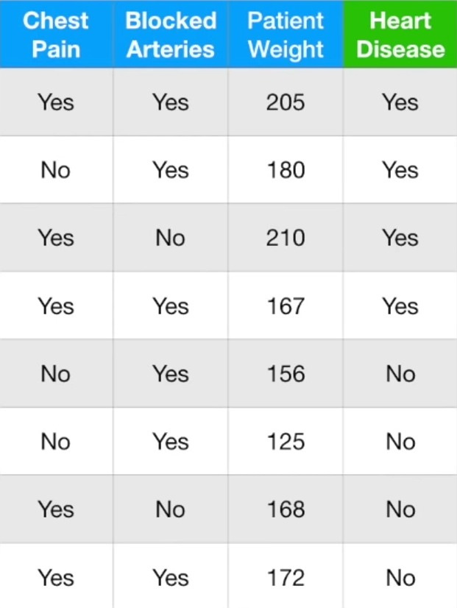
ADABOOST
Let us consdider-

Slide 15
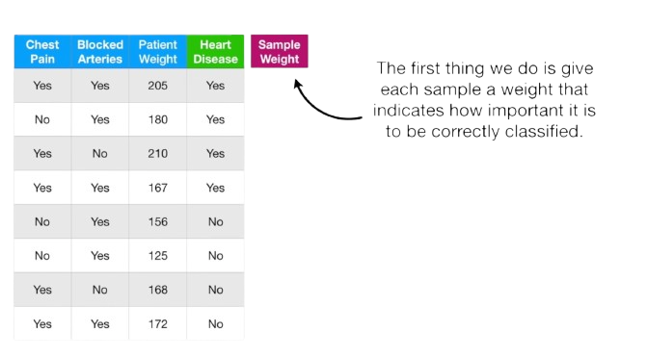
ADABOOST
Let us consdider-
The first thing we do is give each sample a weight that indicates how important it is to be correctly
classified

Slide 16
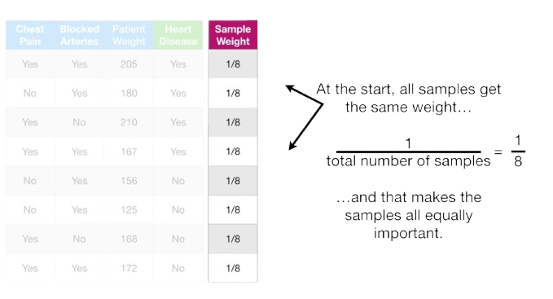
ADABOOST

Slide 17
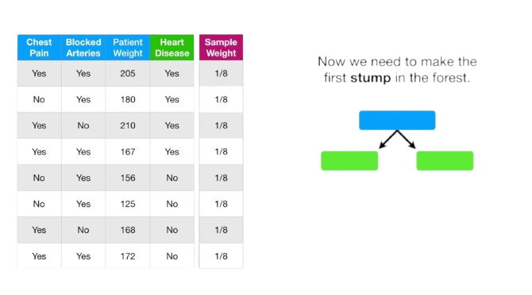
ADABOOST
Now we should make the first stump in the forest

Slide 18
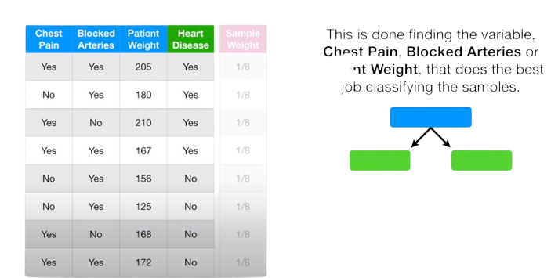
ADABOOST
This is done by finding the variable chest pain, Blocked Arteries or Patient Weight, that does the best job of classifying the samples.

Slide 19
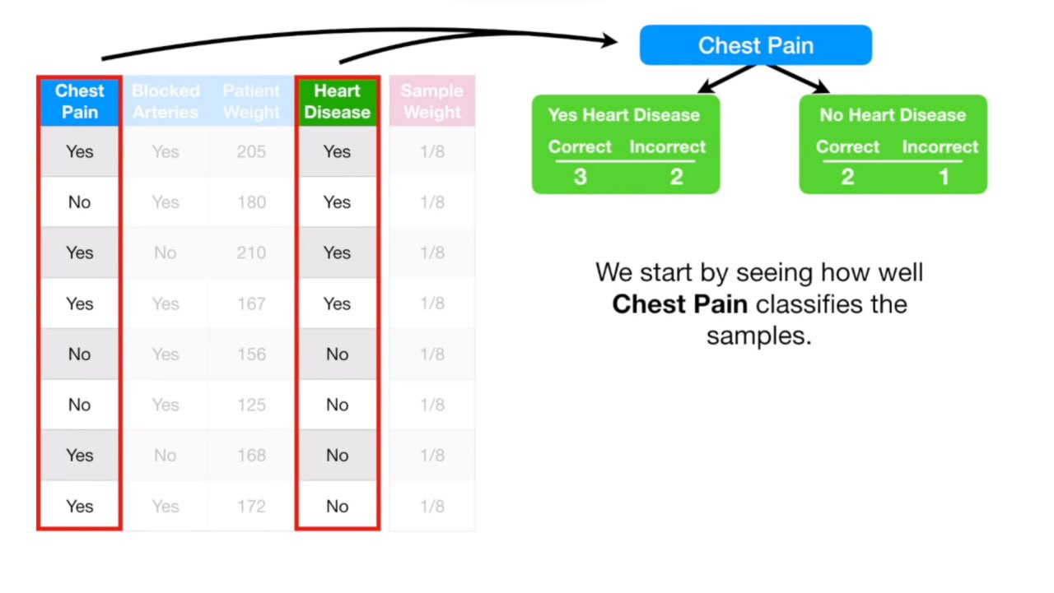
ADABOOST

Slide 20
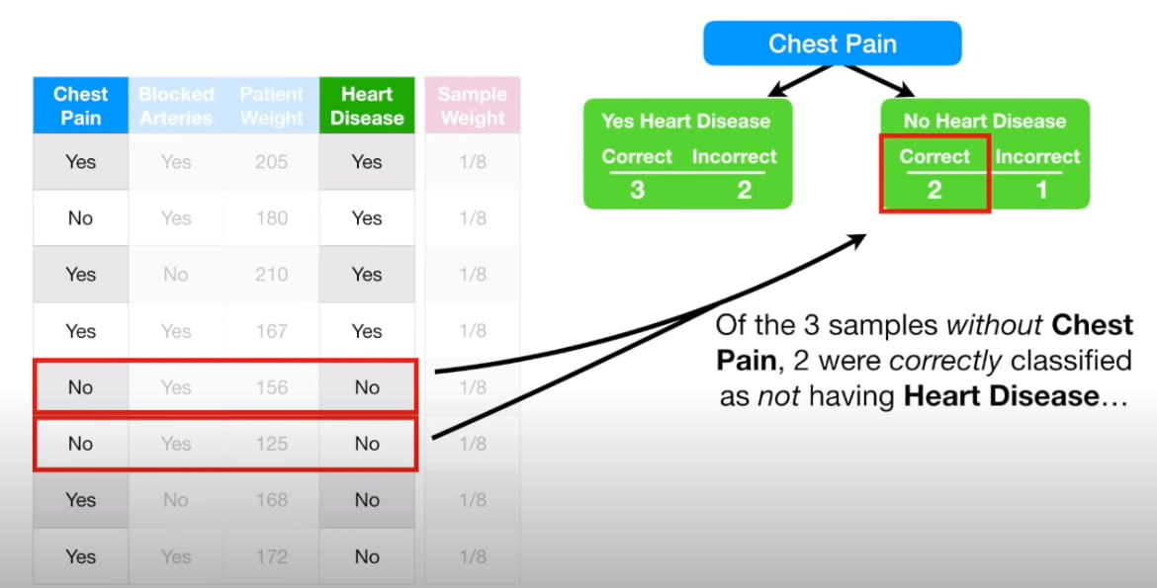
ADABOOST

Slide 21
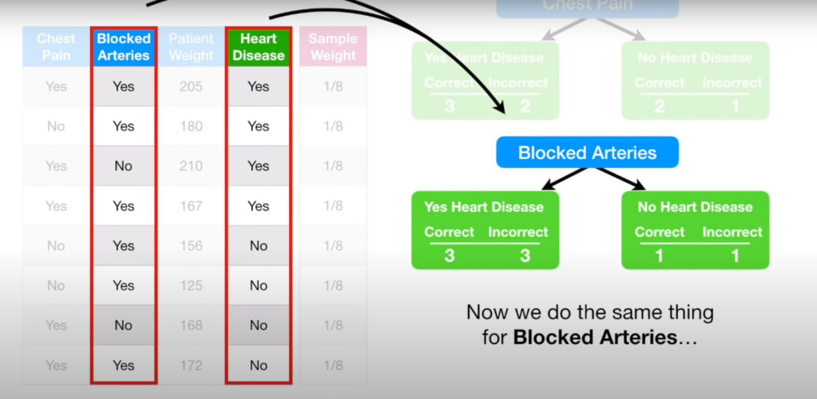
ADABOOST

Slide 22
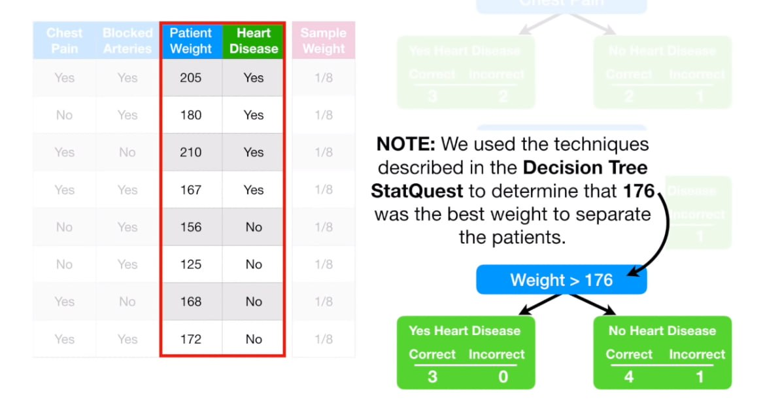
ADABOOST

Slide 23
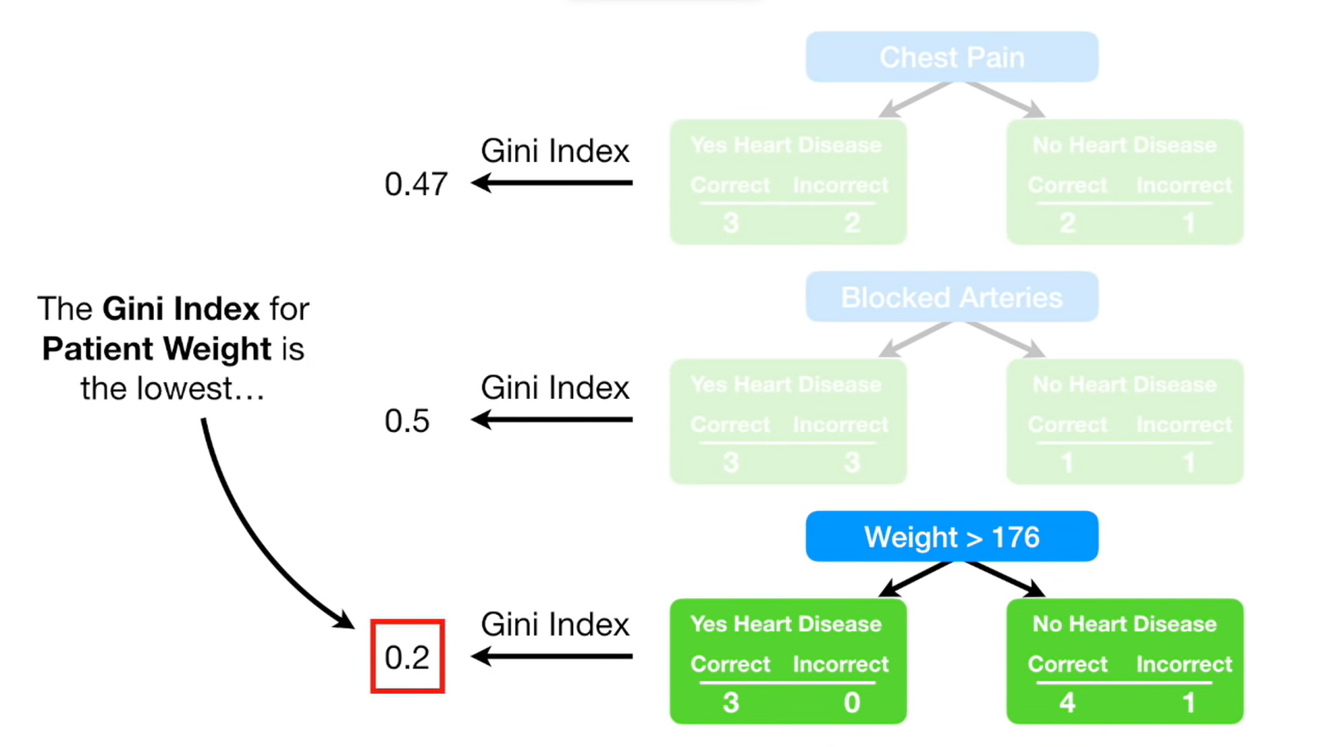
ADABOOST

Slide 24
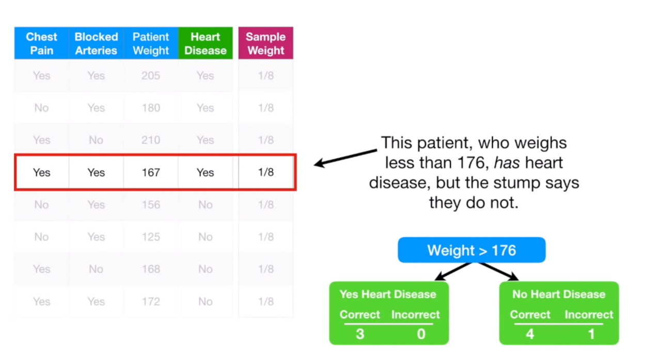
ADABOOST

Slide 25
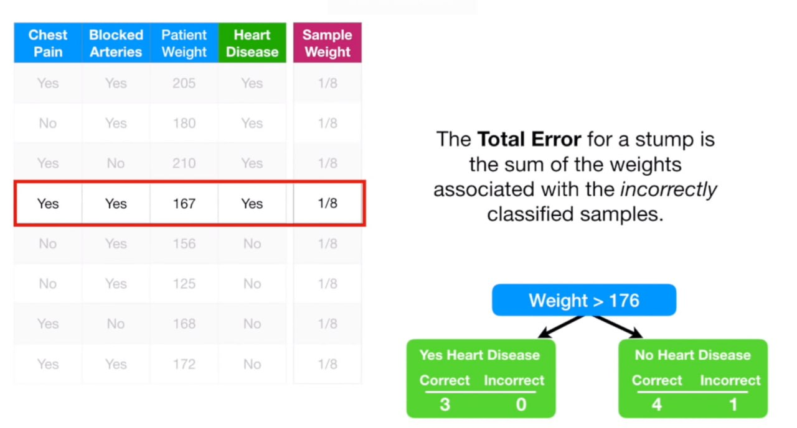
ADABOOST

Slide 26
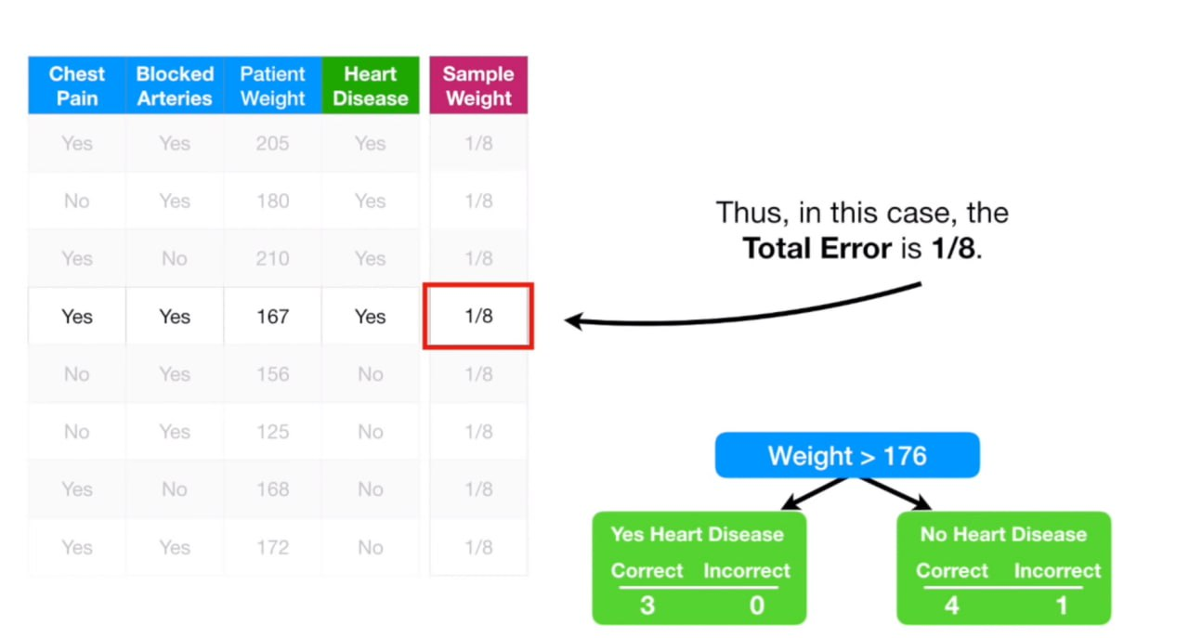
ADABOOST

Slide 27
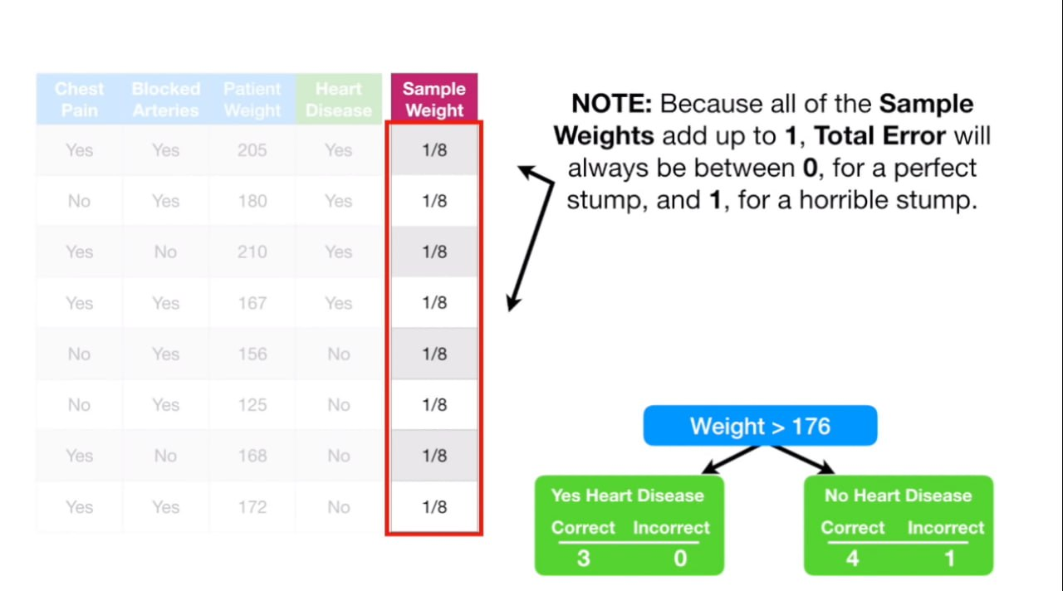
ADABOOST

Slide 28
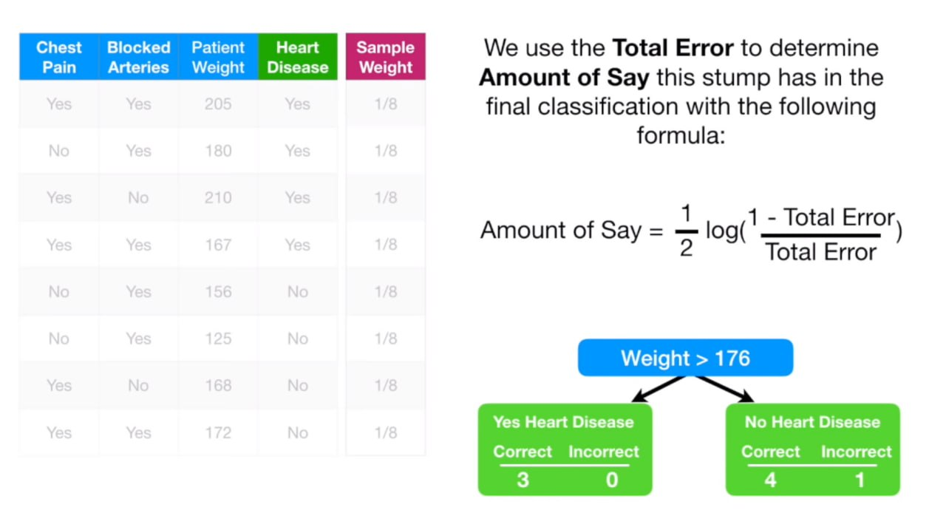
ADABOOST

Slide 29
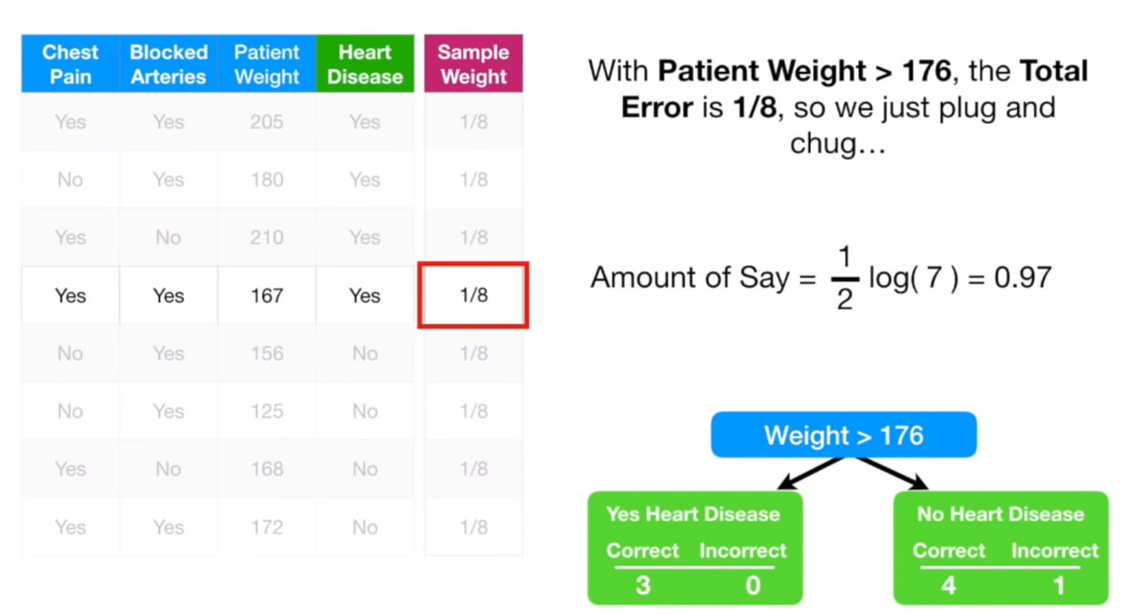
ADABOOST

Slide 30
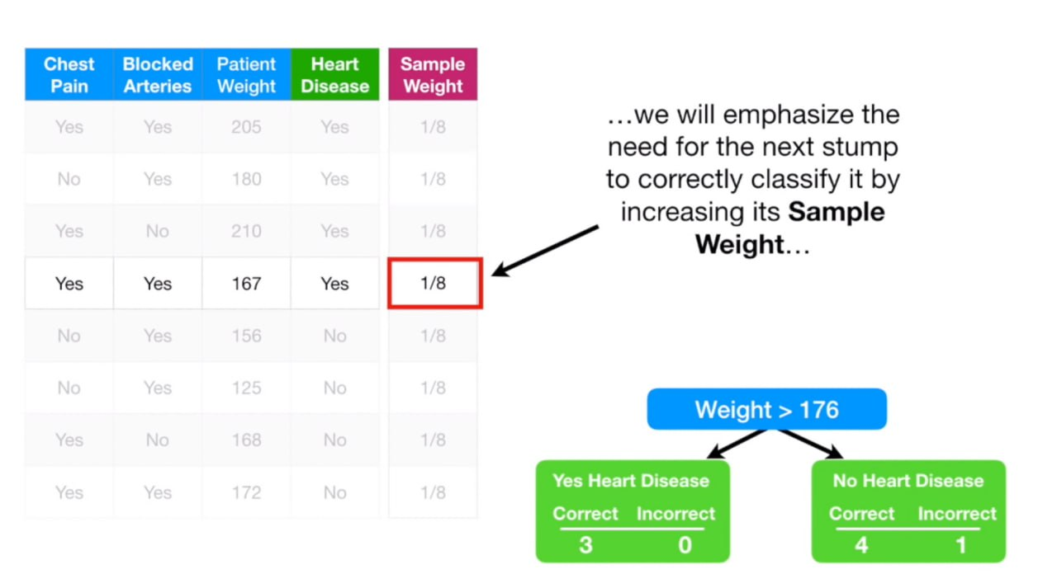
ADABOOST

Slide 31
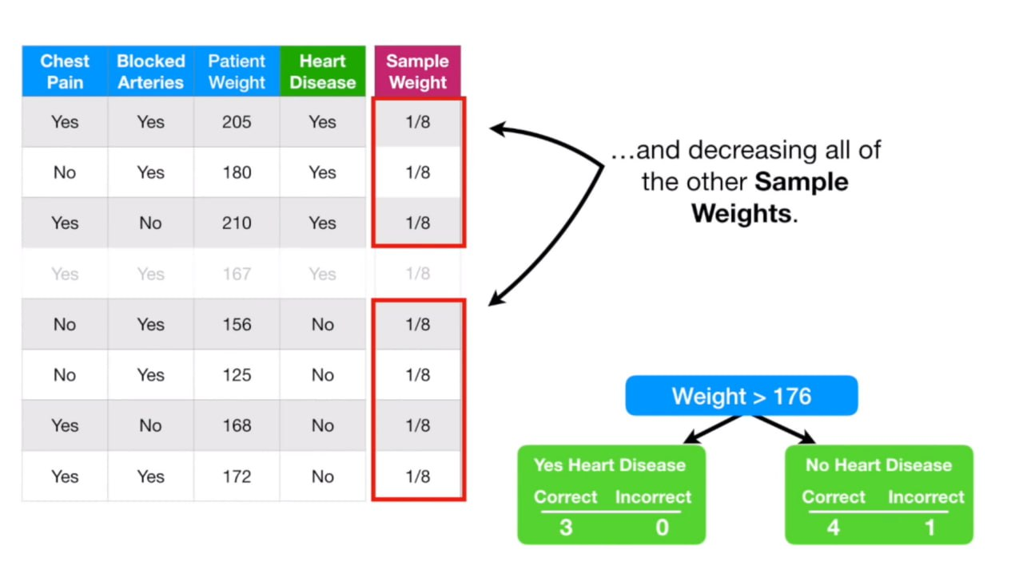
ADABOOST

Slide 32
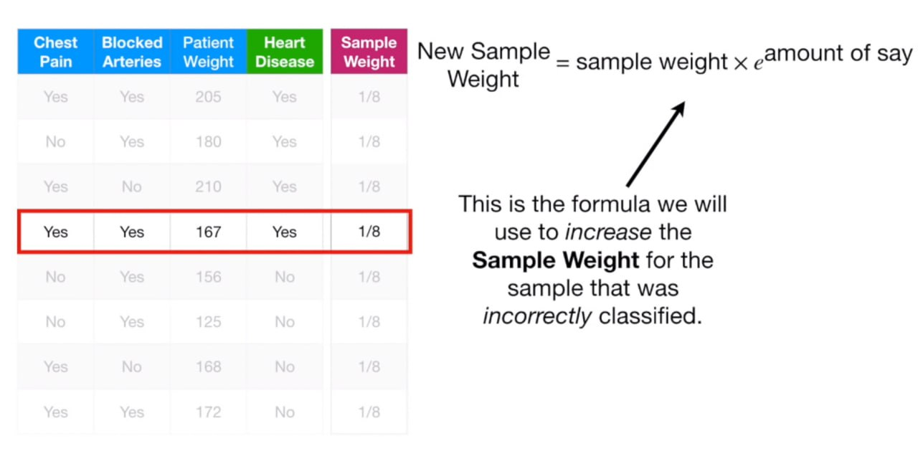
ADABOOST

Slide 33
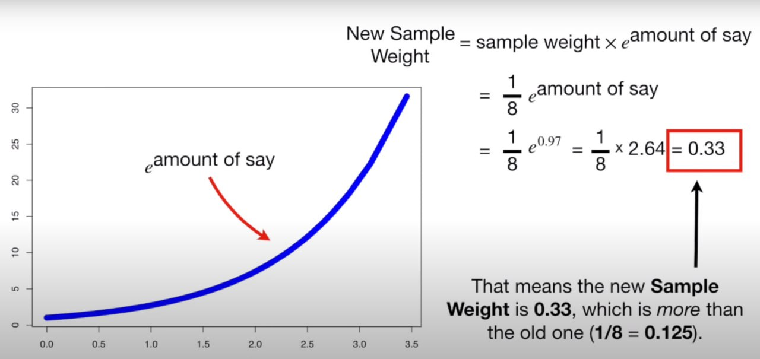
ADABOOST

Slide 34
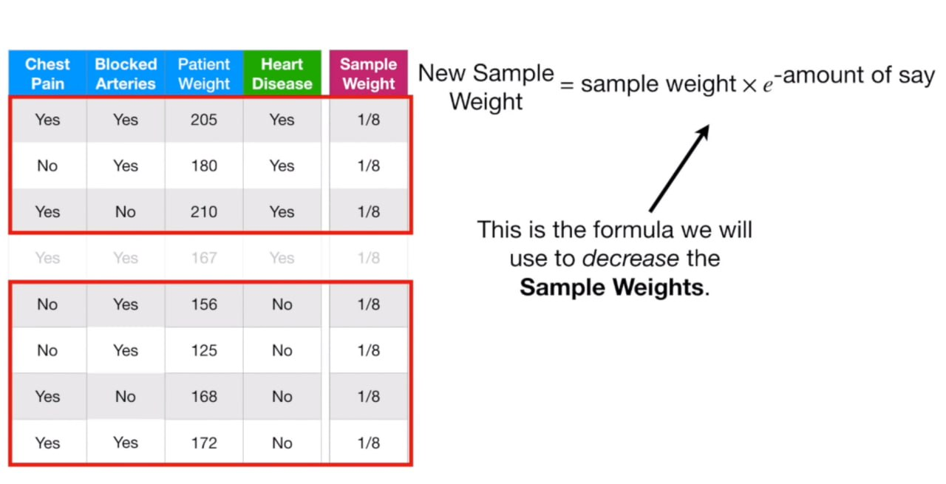
ADABOOST

Slide 35
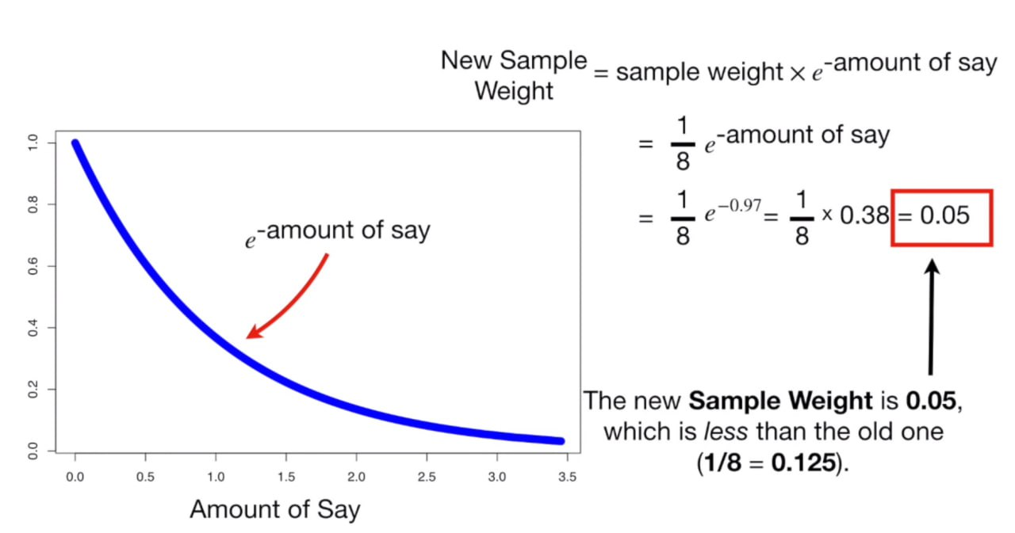
ADABOOST

Slide 36
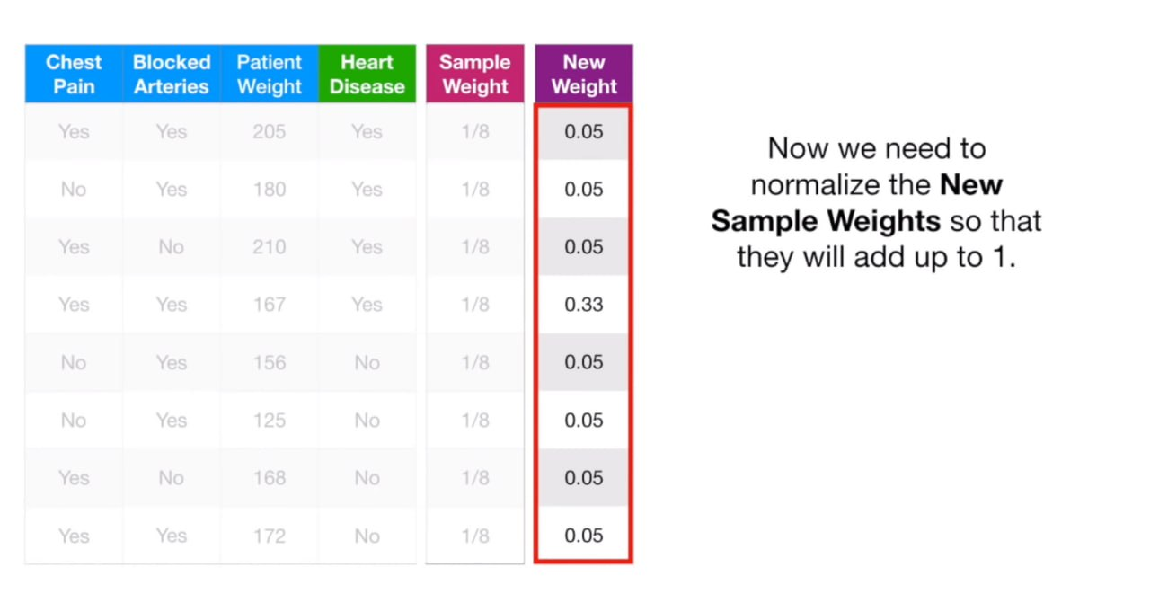
ADABOOST

Slide 37
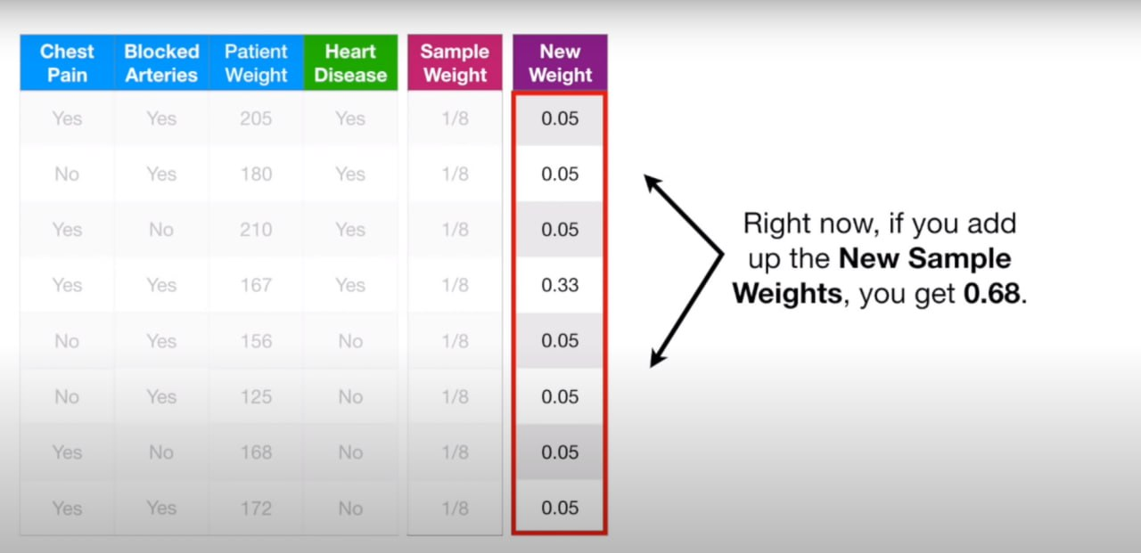
ADABOOST

Slide 38
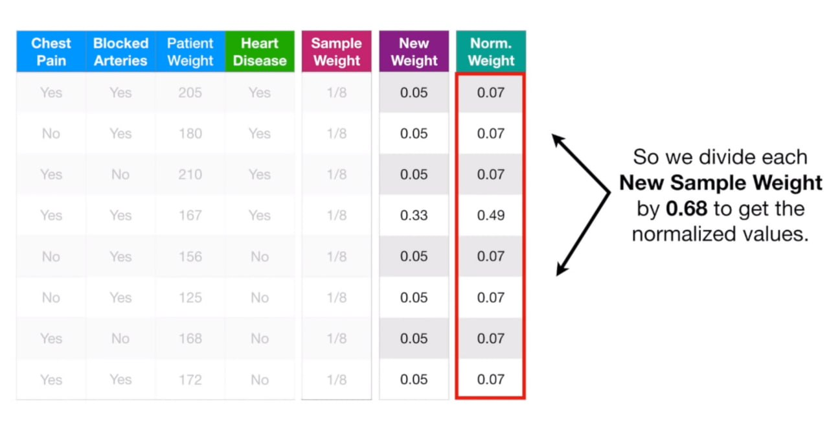
ADABOOST

Slide 39
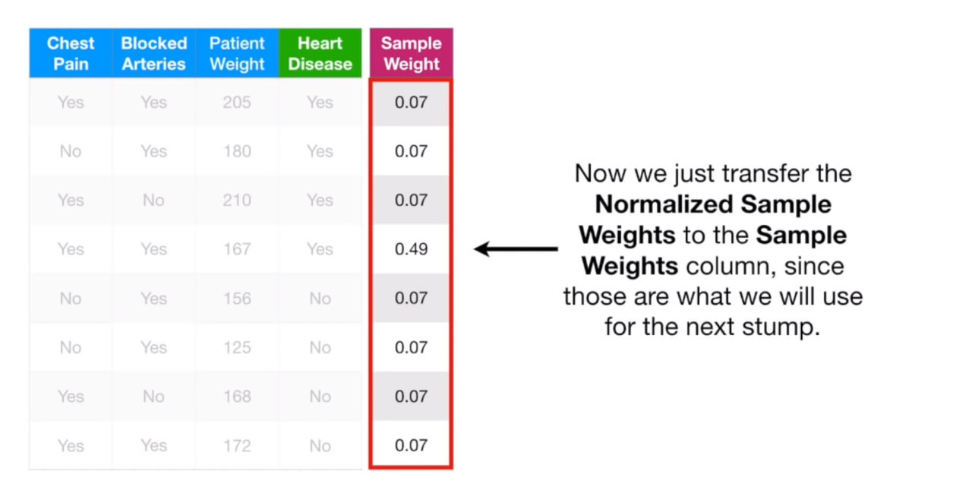
ADABOOST

Slide 40
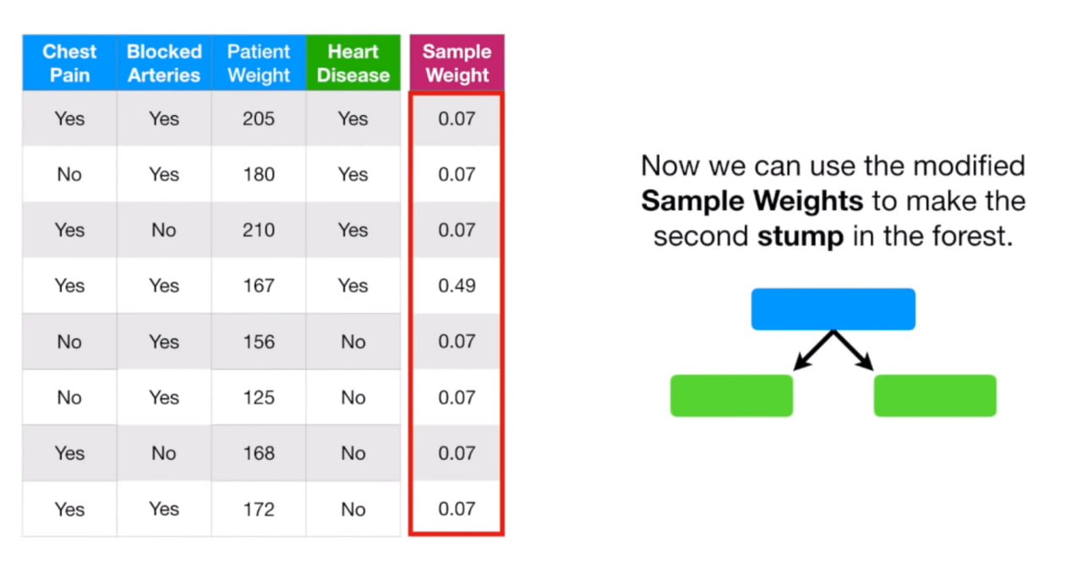
ADABOOST

Slide 41
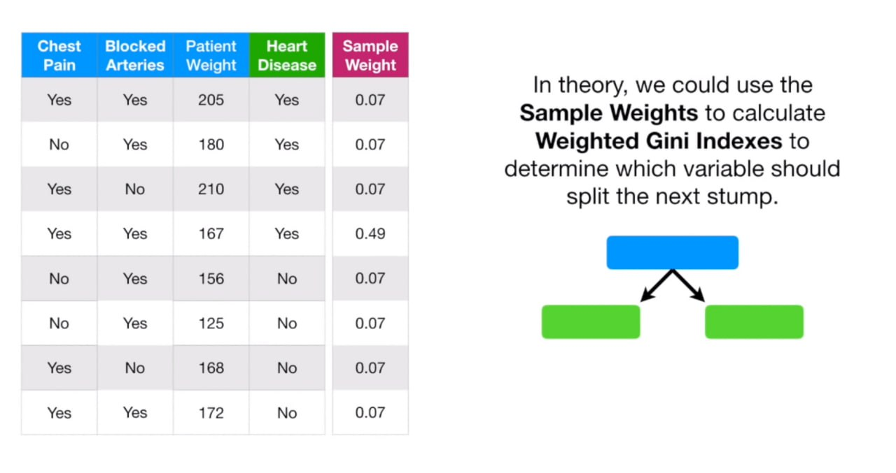
ADABOOST

Slide 42
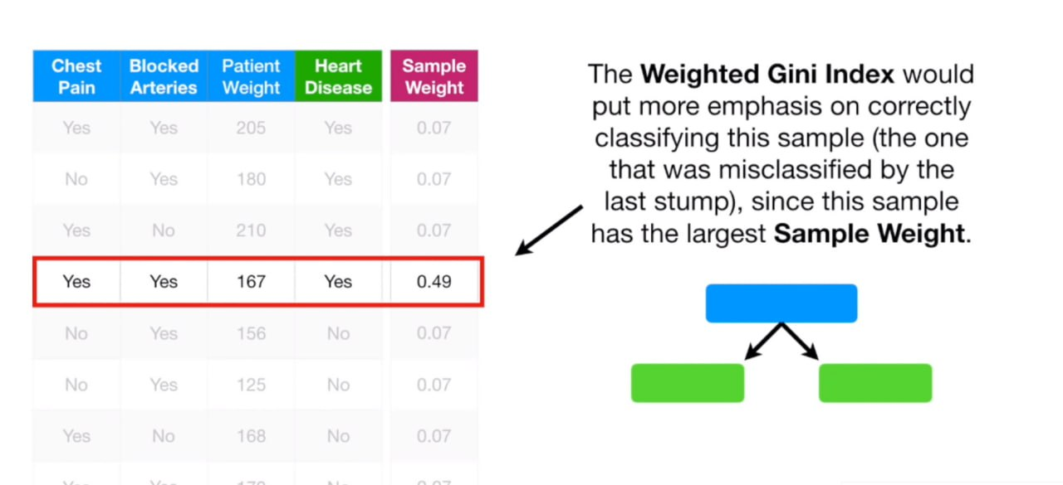
ADABOOST

Slide 43
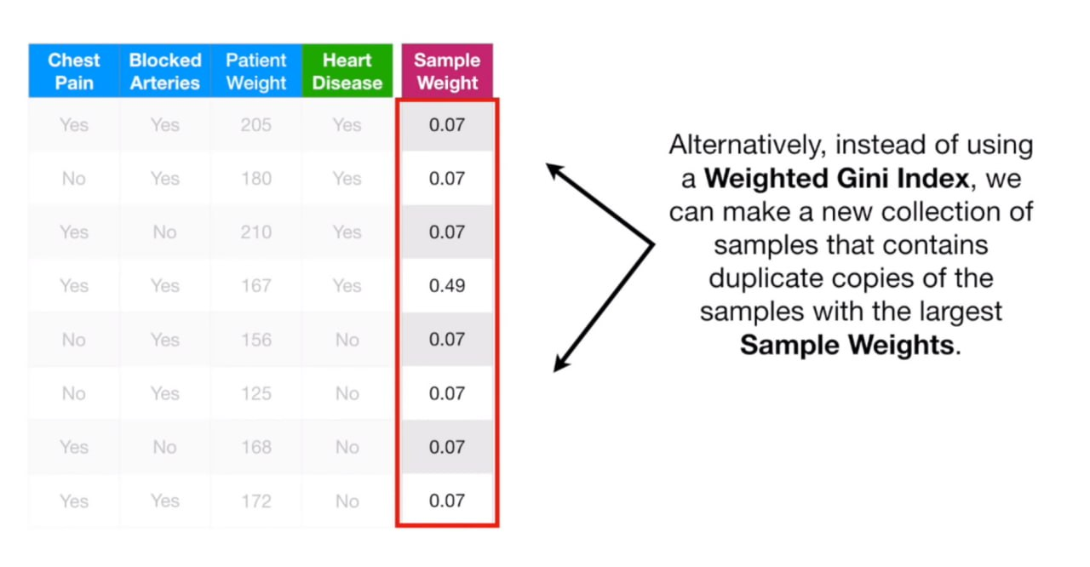
ADABOOST

Slide 44
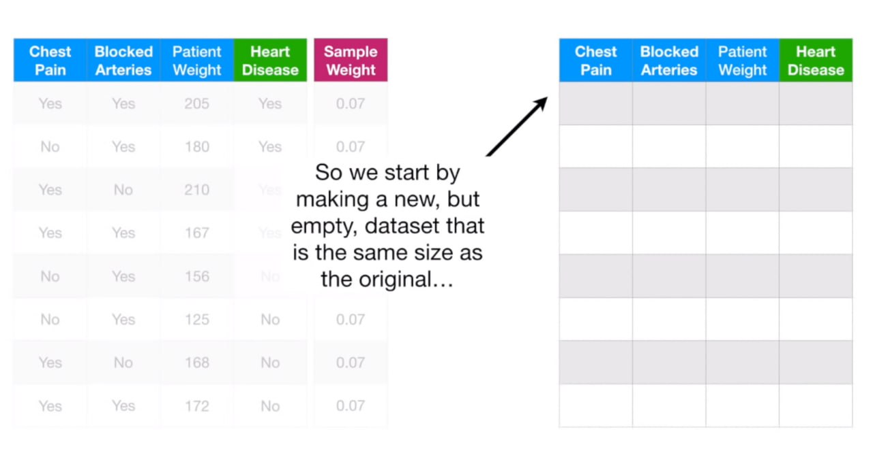
ADABOOST

Slide 45
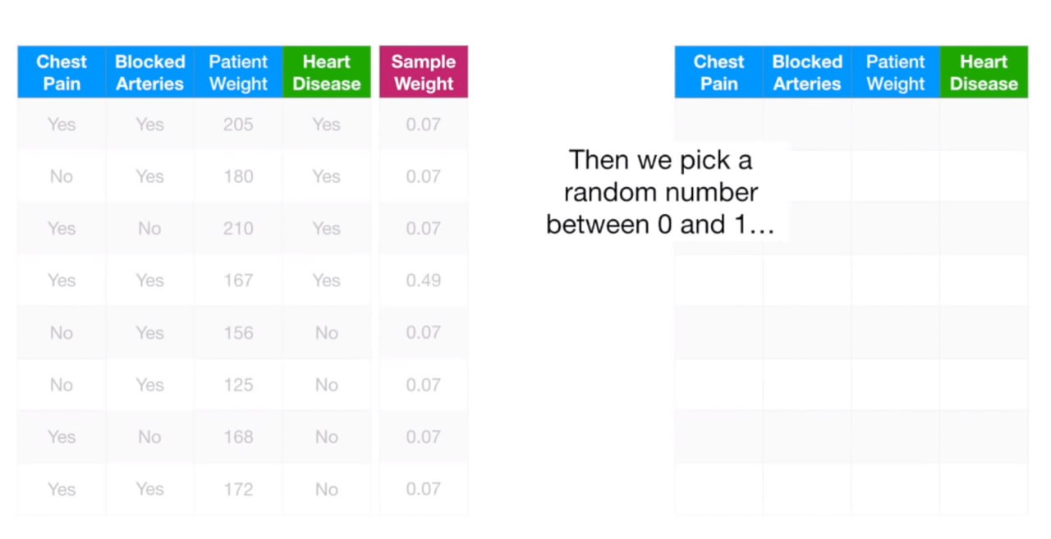
ADABOOST

Slide 46
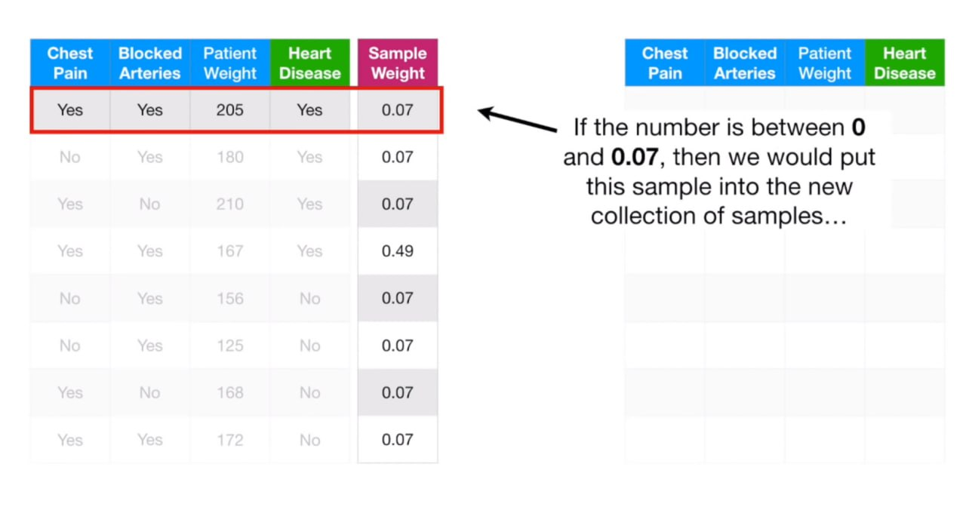
ADABOOST

Slide 47
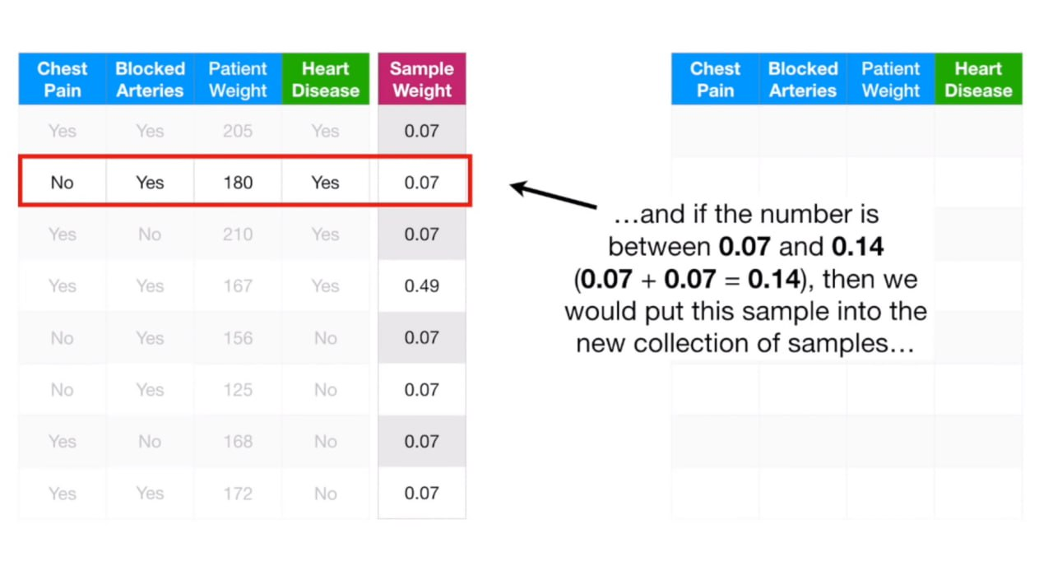
ADABOOST

Slide 48
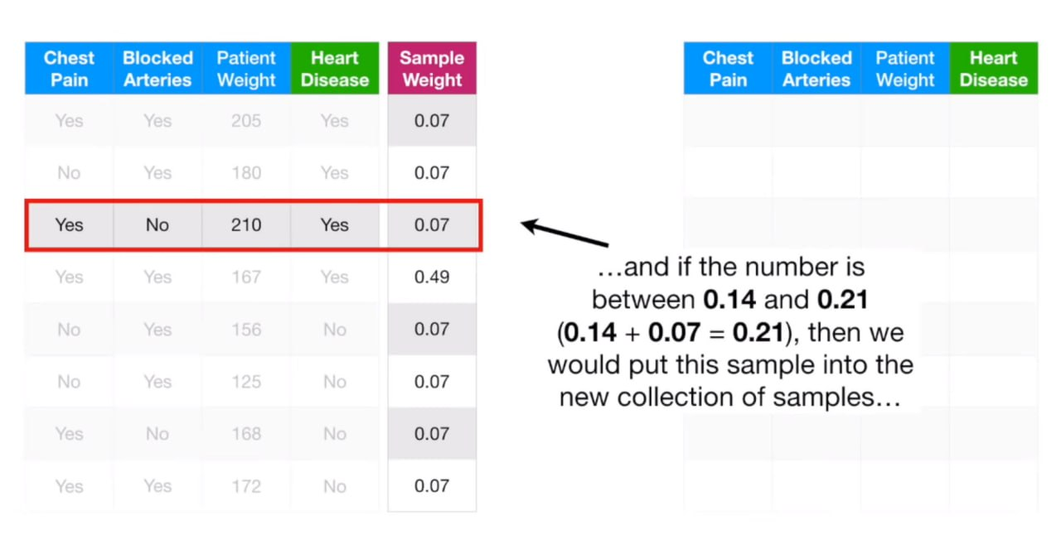
ADABOOST

Slide 49
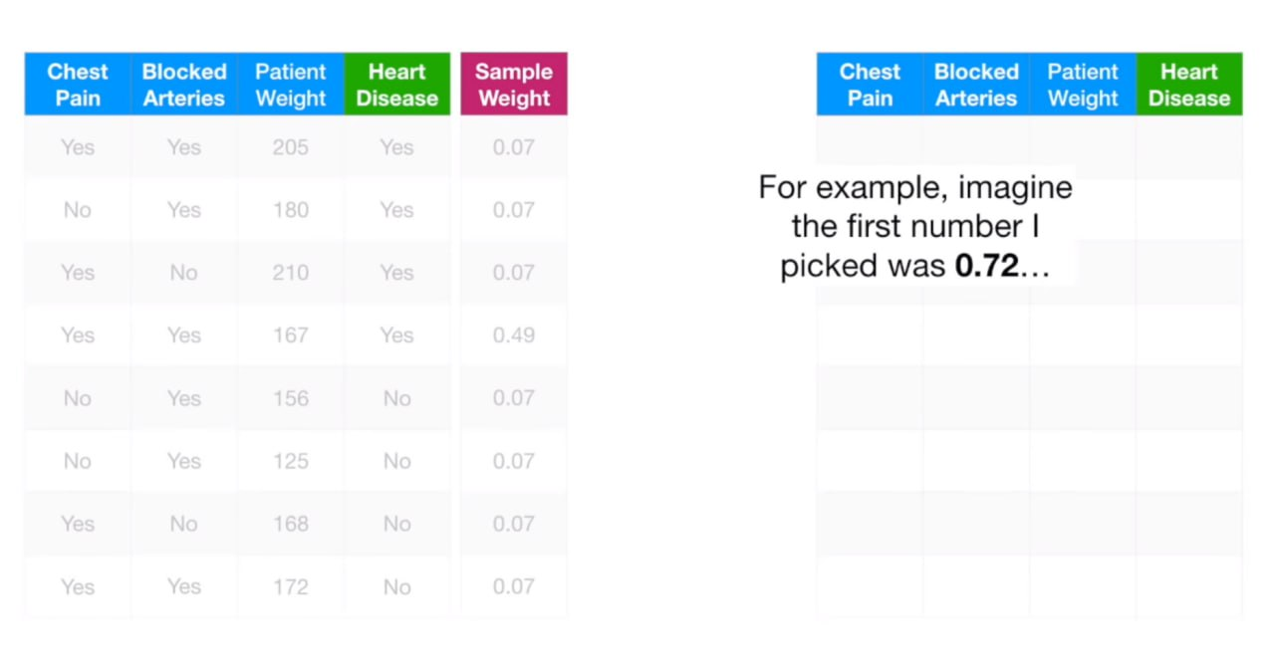
ADABOOST

Slide 50
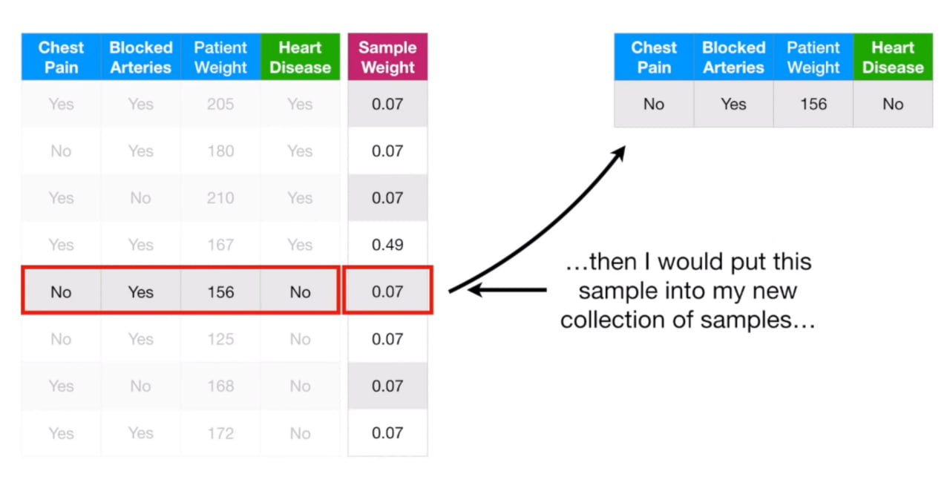
ADABOOST

Slide 51
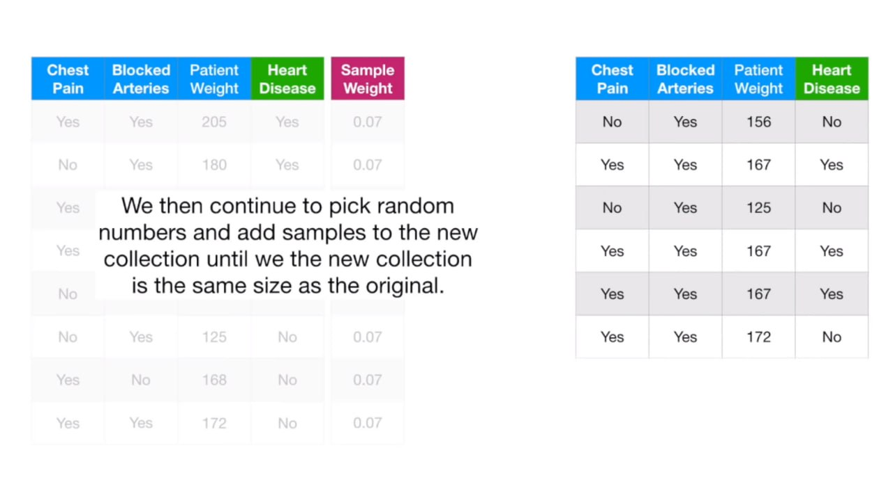
ADABOOST

Slide 52
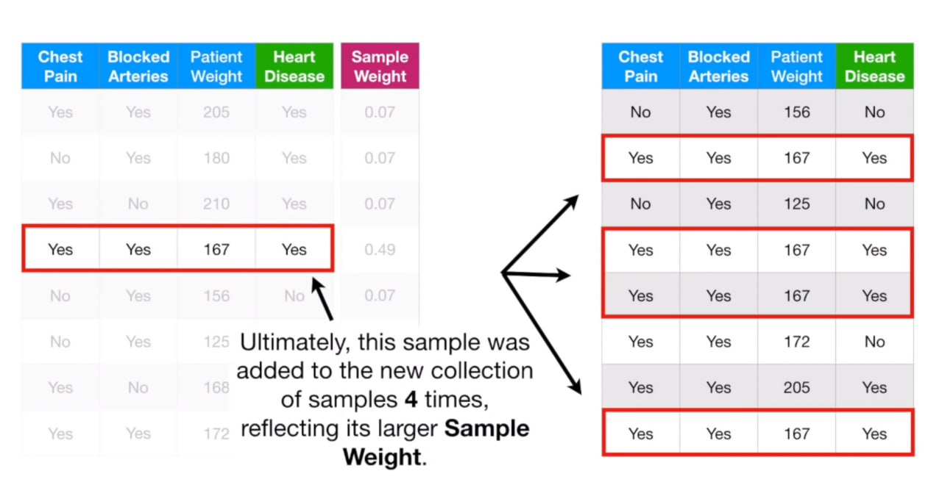
ADABOOST

Slide 53
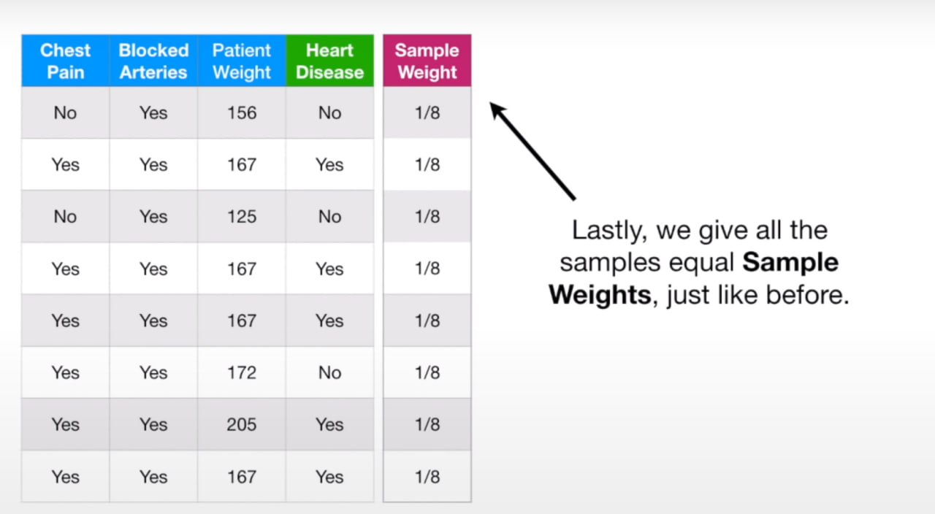
ADABOOST

Slide 54
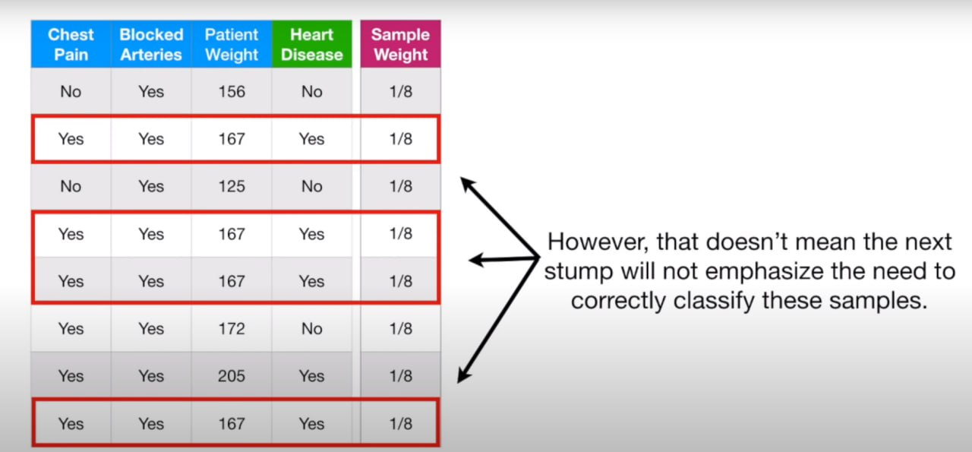
ADABOOST

Slide 55
CONCLUSION
AdaBoost (Adaptive Boosting) is a popular ensemble learning algorithm that combines weak learners to create a strong learner. It was introduced in 1996 and has since been widely used in machine learning.
The algorithm involves initializing weights for training instances, sequentially training weak learners on weighted instances, updating weights based on misclassification rates, calculating importance weights for learners, aggregating predictions, and using the final classifier for predictions.
AdaBoost offers advantages such as improved accuracy, handling complex datasets, and reducing overfitting. However, it is sensitive to noise and outliers and can be computationally expensive. AdaBoost has applications in face detection, text categorization, and fraud detection, among others.
It is often compared to Gradient Boosting and XGBoost. Overall, AdaBoost is a powerful algorithm that leverages weak learners to build a robust and accurate model, making it an effective technique in machine learning.

Slide 56
Thank You

